Slide 1
Bayesian Integration in Sensorimotor Learning
KONRAD P. KÖRDING & DANIEL M. WOLPERT
LETTERS TO NATURE, 2004

Slide 2
Introduction
Human senses provide imperfect information, forcing humans to estimate.
According to Bayesian theory an optimal estimate results from combining information about the prior distribution with evidence from sensory feedback.
As uncertainty increases the system should increasingly rely on prior knowledge.
Nervous system architecture may be suitable for Bayesian inference.

Slide 3


Bayes’ Theorem in Perception - Demo

Slide 4
Do humans behave in a Bayes-optimal manner?
THIS RESEARCH COMPARES 3 DIFFERENT POSSIBLE MODELS TO SEE WHICH IS CONSISTENT WITH HUMAN BEHAVIOR

Slide 5
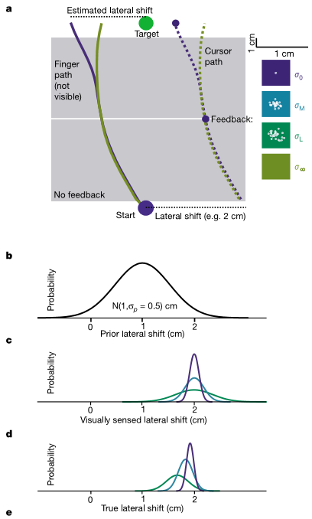
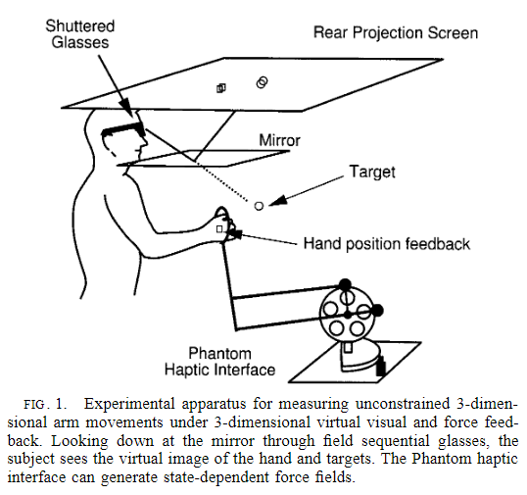
Methods
Subjects reached to a visual target in a set-up that shifted the visual feedback of their finger.
The lateral shift was randomly drawn from a prior distribution ~ N(1, 0.5²).
This feedback was either provided clearly, blurred (medium or large amount), or withheld.
10 subjects were trained for 1,000 trials.

Slide 6
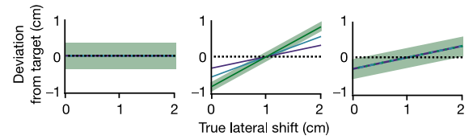
Possible models
MODEL 1 – FULL COMPENSATION
MODEL 2 - BAYESIAN
MODEL 3 – MAPPING
No using priors.
Subjects compensate for the visual estimate of the lateral shift.
Increasing uncertainty affects variability of pointing but not the average location.
Using priors.
And using visual estimate optimally.
Increasing uncertainty affects variability and average location – such that the more uncertainty there is the more subjects rely on prior.
No using priors.
learn a mapping from the visual feedback to an estimate of the lateral shift, using the error at the end of each trial.
Increasing uncertainty will affect the variability but not the average location.

Slide 7
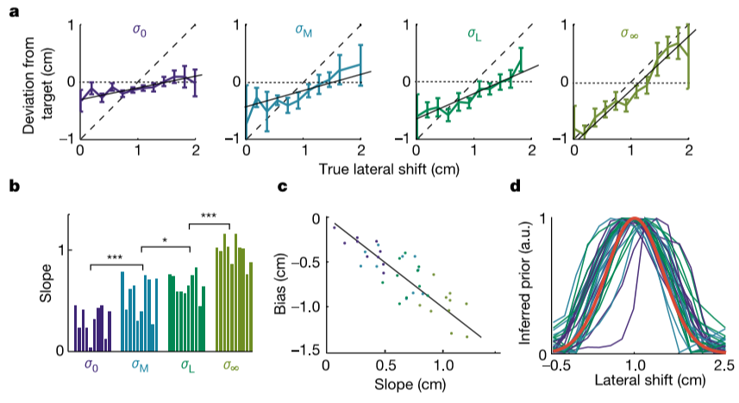
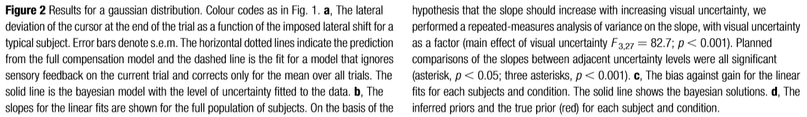
Results

Slide 8
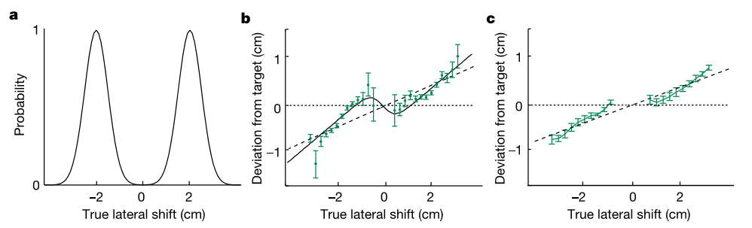
Results – bimodal distribution

Slide 9
Conclusions
Human inference seems to take into account prior information and current sensory feedback with uncertainty.
There results qualitatively match a Bayesian integration process.
Such a Bayesian process might be fundamental to all aspects of sensorimotor control and learning.

Slide 10
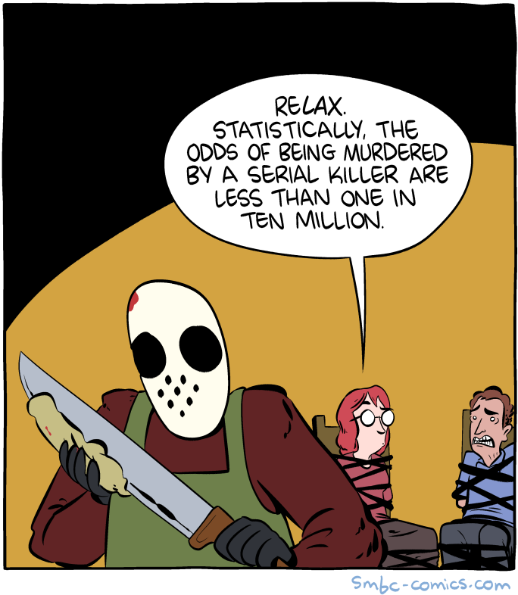
Thanks for listening!
Benjamin Menashe – Signal Processing 2022

